Slide 1
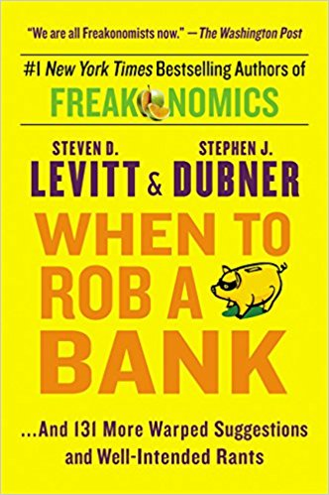
Which Banks To Rob?
Inspired by
When to Rob a Bank
Stephen D. Levitt & Stephen J. Dubner

Slide 2
Project
Use machine learning to identify vulnerable banks for robbery based on $$$ deposits, distance from police stations, armed civilians, bank ratings, number of officers, and crime rates.
https://github.com/hhalim/TargetBanks/
https://github.com/hhalim/TargetBanksJupyter

Slide 3
Bank Crime Statistics
4251 robberies in 2016.
Friday (913) is the day with the most frequent robberies, Sun (51) the least.
3 Average number of successful bank heists before a robber is caught
177 out of 240 guards on duty during robbery.
8 robbers injured (0.002%) out of 4251 robberies. Guard 2, Employee 23, Customer 9.
Most robberies: Texas (301), New York(371), California (462), Minnesota (58)
110 explosive devices used. 1001 firearms used (965 handguns).
Single robber US $4,210 average. UK $18,000. More robbers yield bigger $$$.
Only 22% of U.S. bank robberies where the cash was recovered.

Slide 4
Security Devices
Alarm System 4,085
Surveillance Cameras 4,210
Bait Money 1,942
Guards 224
Currency Dye/Gas Packs 709
Electronic Tracking Devices 595
Bullet-Resistant Enclosures 610
Access-Controlled Entry-Way 56
Man Trap 36

Slide 5
Data Gathering
FBI Crime Data https://ucr.fbi.gov/crime-in-the-u.s./2016
FBI Police Employment Numbers https://ucr.fbi.gov/crime-in-the-u.s/2016/crime-in-the-u.s.-2016/tables/table-26/table-26.xls/view
Federal Firearms License Holders https://www.atf.gov/resource-center/data-statistics
Federal Deposit Insurance Corporations http://www5.fdic.gov
Policeone.com http://www.policeone.com/law-enforcement-directory/
Google Place API for ratings and reviews.

Slide 6
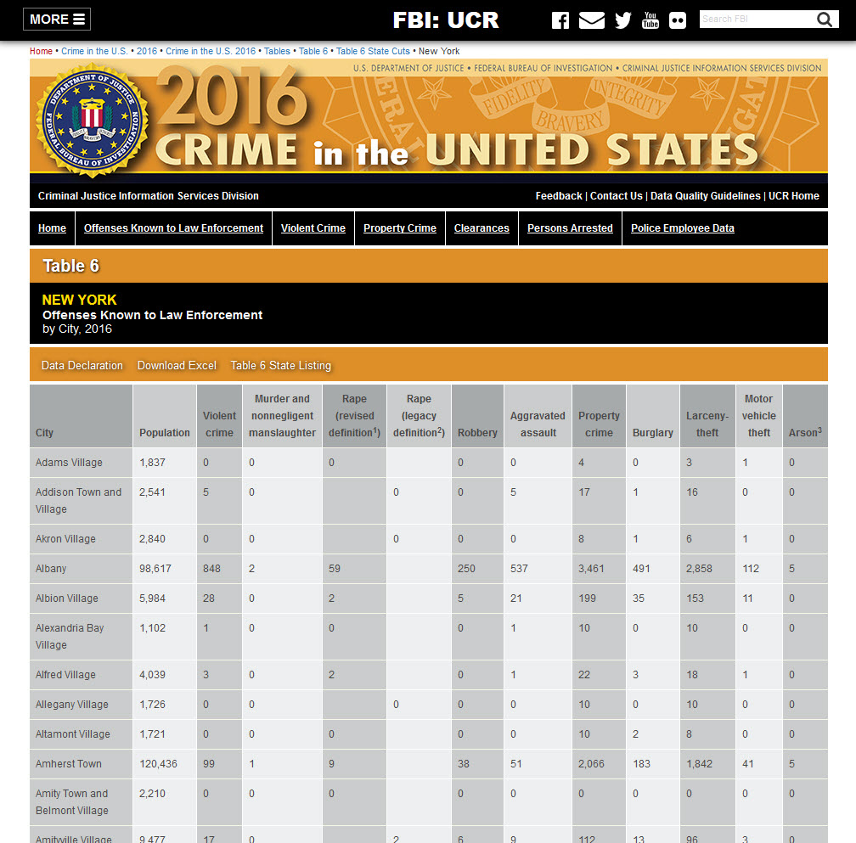
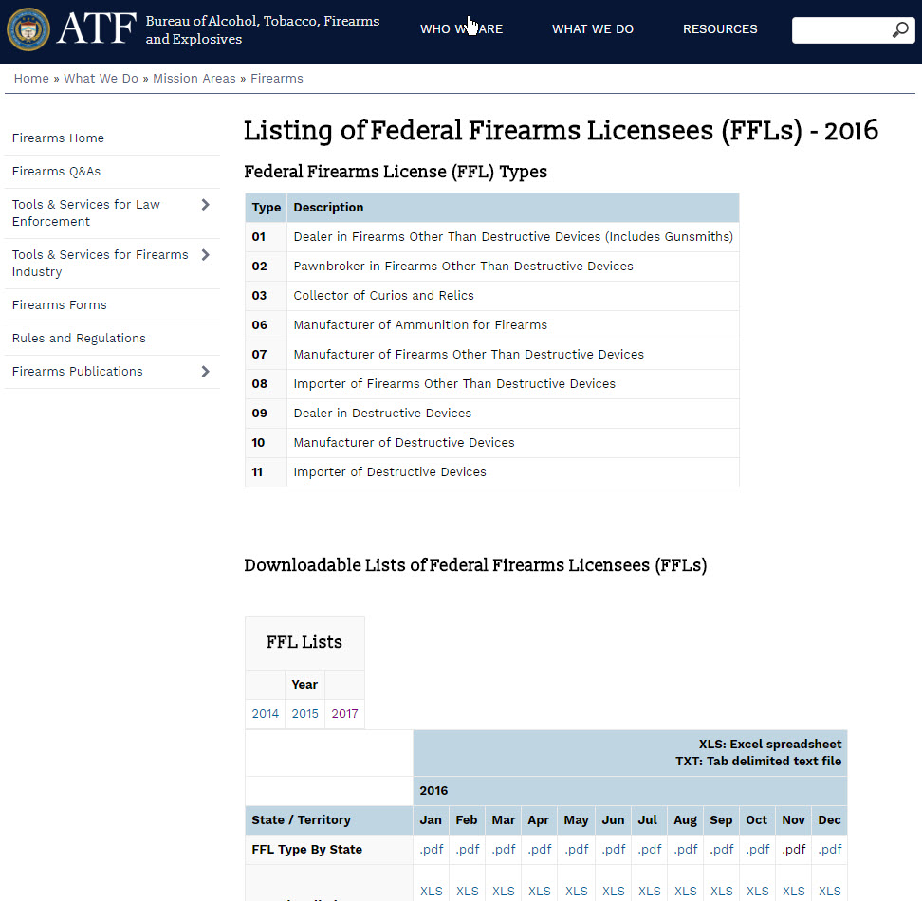

Slide 7
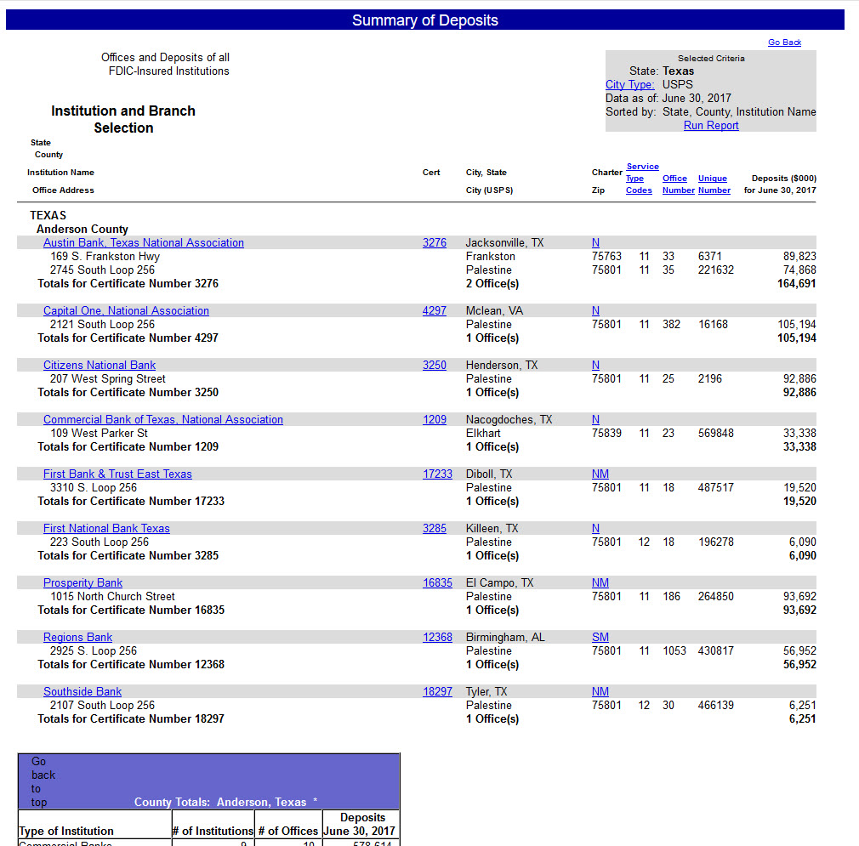
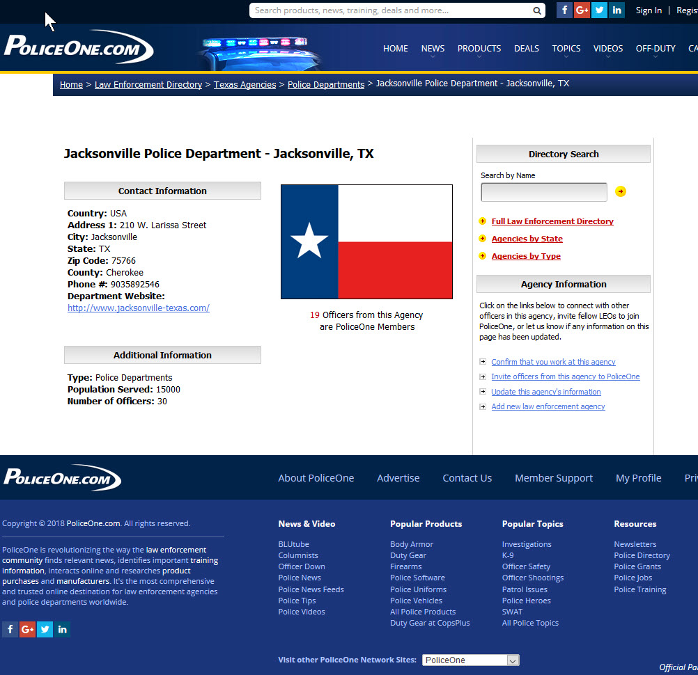

Slide 8
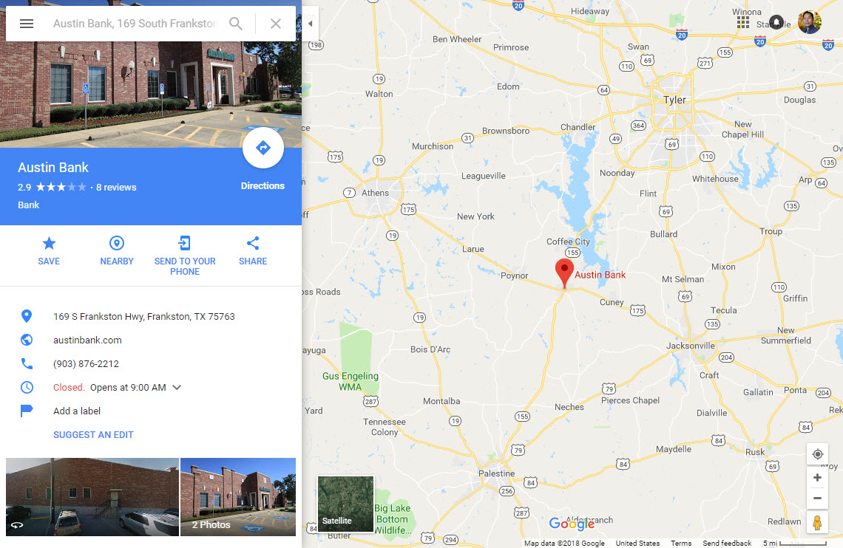
Notes:
From FDIC website, first line: Austin Bank, Frankston

Slide 9
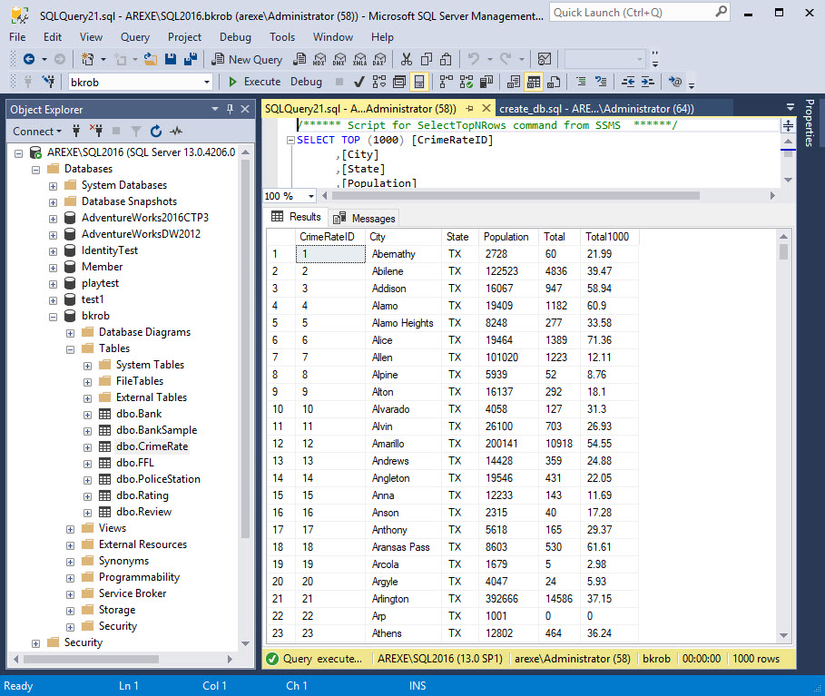

Slide 10
Assumptions
High $$$ amount increases the probability of a bank as a target.
Distance to police stations increases the probability of getting caught.
High crime rate reduces response time by police officers.
Armed civilians may interfere during robbery, reduces probability of success.
More officers increase the ability to intercept robbers.

Slide 11
Data Cleaning, Imputation, Features
Manually remove duplicates, fill in some missing data, fix wrong addresses.
Get latitude and longitude data using Google map API.
Add Features:
Count the closest Police Stations within 10 miles for each bank.
Find closest distance to the Police Station for each bank.
Count the FFL within 5 miles for each bank.
Calculate officers number per 1000 population.
Calculate possible $$$ take for each bank (0.05% of FDIC deposit)
Probability of getting caught by closest distance to Police Stations
y = 70 – 10x

Slide 12
Supervised Learning Model
Sample 10% from all the banks data (sample.sql).
From this sample, use algorithm to decide whether a bank is a potential target or not (target.py).
Classify group 1 – 5 based on $ take and probability of success.
Probability of success formula:
1 - (((pDistance * 0.75) + (pPoliceResp * 0.25)) * 0.65) - (pArmed * 0.20) - (pRating * 0.15)
Police Response: pPoliceResp = -0.1 + (0.4 * officersRate)
Civ. Armed Response: pArmed = -0.004444 + (0.0206 * fflCount)
Rating: pRating = 0 + (0.1 * avgRating)

Slide 13
Machine Learning
Supervised Model: modeling.ipynb
Unsupervised Model: K-Means modeling KMeans_TX.ipynb
Use models for TX and NY:
Prediction_TX.ipynb
Prediction_NY.ipynb

Slide 14
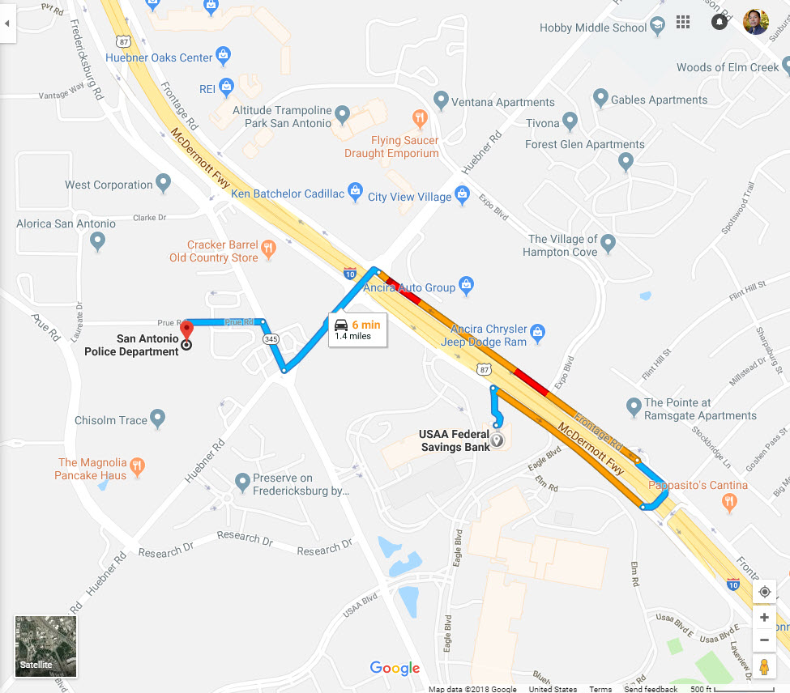
USAA Federal Savings Bank
San Antonio, TX

Slide 15
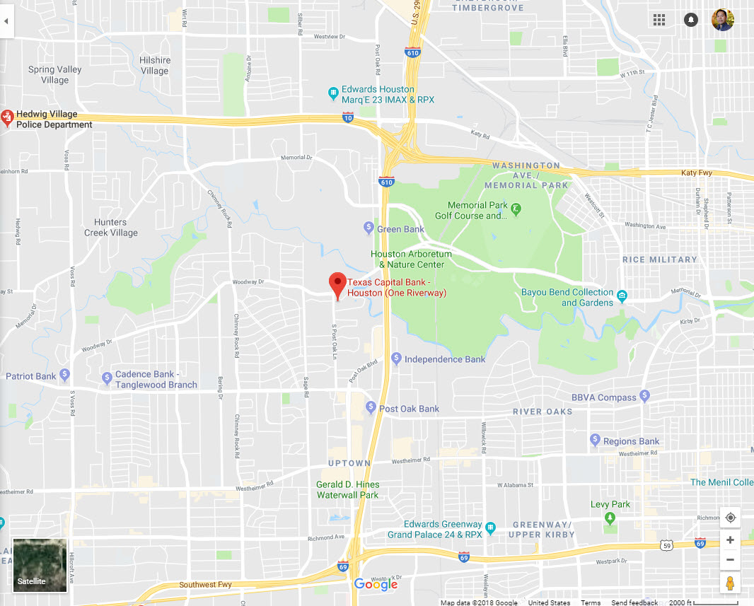
Texas Capital Bank
Houston, TX

Slide 16
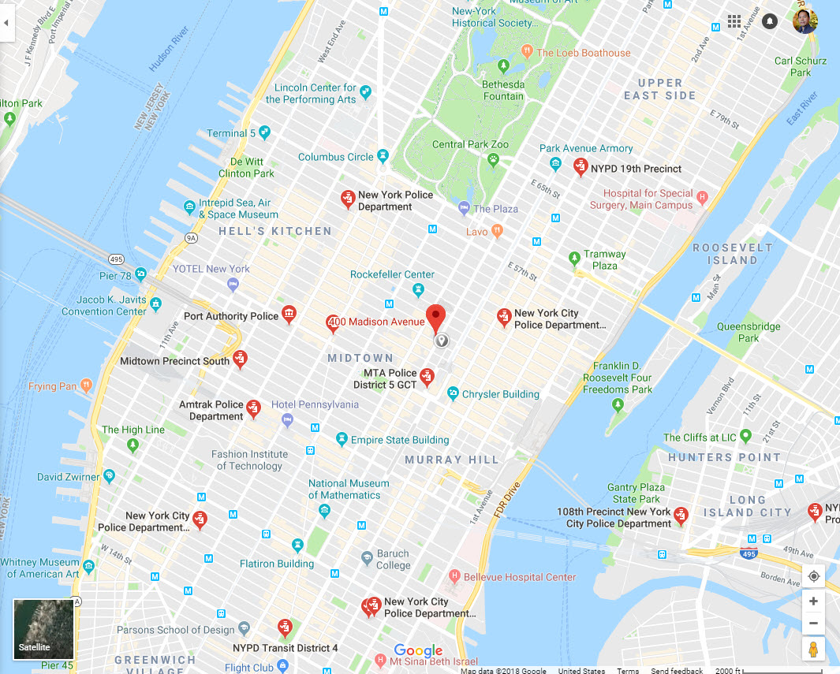
JPMorgan Chase Bank
New York, NY

Slide 17
What did I learn?
Finding source of good data is very challenging.
Data wrangling is challenging.
Missing data produce false positives and many inaccuracies even with well trained model.
Machine learning is the first step for bank security.
Supervised ML is only as useful as the initial assumptions I made for this project.
Unsupervised model is not useful in this project.

Slide 18
More
What more interesting things to do if I have more time?
Google map API for additional police stations data.
Manhattan distance, instead of straight distance calculation.
Yelp ratings and reviews.
Natural Language Processing for reviews.
Automated gathering and cleaning for the data.
Traffic density and time.
Move DB to MySQL open source.

